Slide 1
Concurrency Control
Enforcing Serializability: Locking

Slide 2
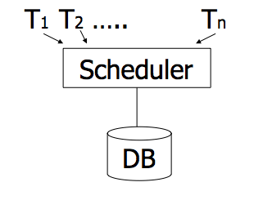
Enforcing Serializable Schedules
DBMSs use a “Scheduler” that schedules the actions of transactions
Transactions send their requests (R or W) to Scheduler
The scheduler prevents the formation of cycles
  It grants permission to R or W only if no cycle will be formed

Slide 3
Locking Protocol
“Scheduler” uses a locking protocol to enforce serializability
Two New actions
  Lock (exclusive): l_{i}(A) ➔ Transaction Ti locks item A
  Unlock: Ui(A) ➔ Transaction Ti unlocks (releases) item A
lock
table

Slide 4
Rule #1: Well-Formed Transactions
Ti: … li(A) … pi(A) … ui(A) ...
Any action (R/W) must be after the lock (l) and before the unlock (u)
Rule 1 is at the level of each transaction independent of the others

Slide 5
Rule #2 Legal Scheduler
S = …….. li(A) ………... ui(A) ……...
no lj(A)
No transaction Tj can lock item A that is already locked by another transaction Ti
(Transaction Tj must wait until Ti releases its lock)
Rule 2 is at the level of the complete schedule (Set of interleaving transactions)

Slide 6
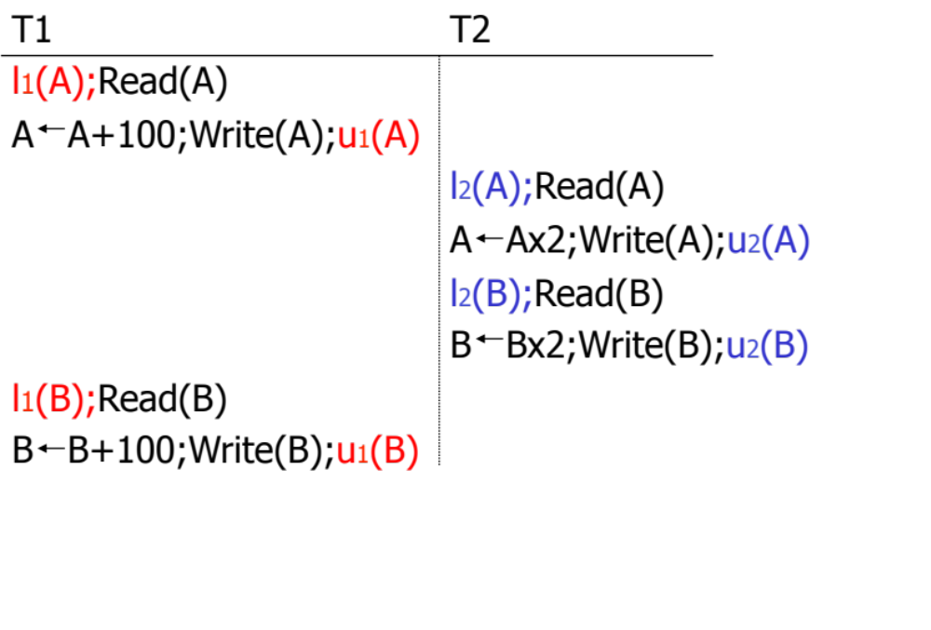

Schedule F: Let’s Add Some Locking!
Does the locking mechanism work? Does it guarantee serializable schedule??

Slide 7
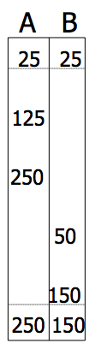
Still Something is Missing…
Still by applying the locks….result is not consistent !!!

Slide 8
Rule #3 Two Phase Locking (2PL)
Ti = ……. li(A) ………... ui(A) ……...
No unlocks
No locks
A transaction never starts unlocks until it takes all its locks.
In other words: Take all locks before the first unlock
Rule 3 is for each transaction…

Slide 9
2 Phase Locking Protocol
# of locks held by a transaction
Collect locks
Release locks
Growing Phase
Shrinking Phase

Slide 10

Schedule F : Does it follow 2PL ?
➔ Both transactions violate 2PL

Slide 11
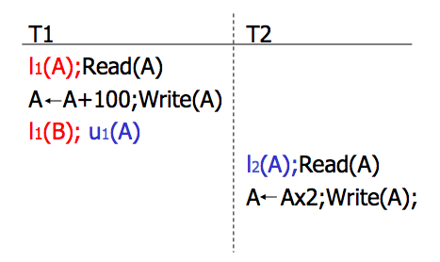
Example 2PL: Schedule G
Scheduler will deny this request
(T2 will wait…)
l₂(B)

Slide 12

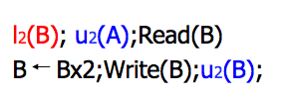
Example 2PL: Schedule G
Scheduler will deny this request
(T2 will wait…)
l₂(B)
T2 Continue processing
At this point the scheduler can resume T2

Slide 13
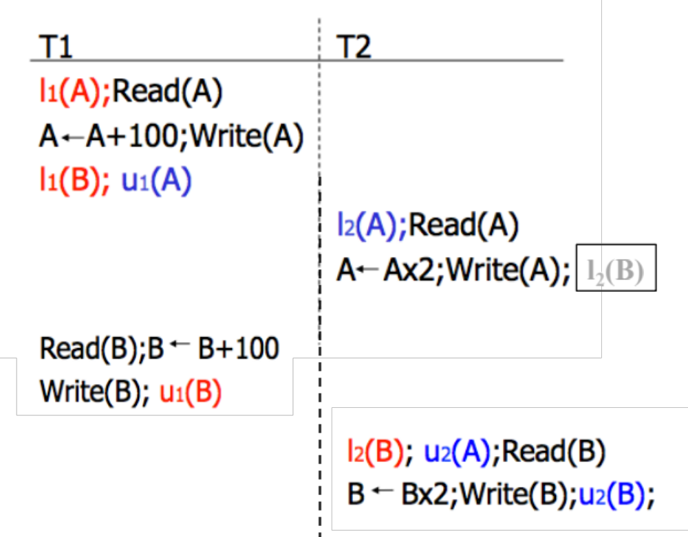
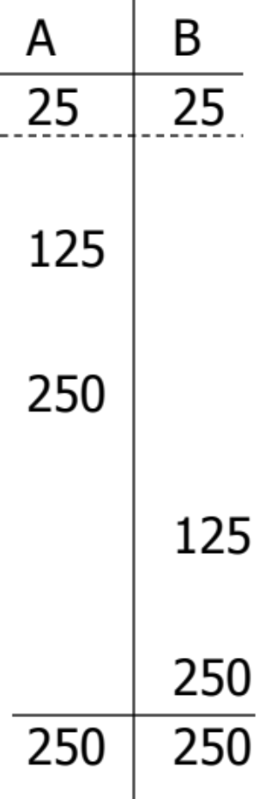
Scheduler Forced Schedule G to be Serializable

Slide 14
Theorem
Any legal schedule S following the 2PL
  ➔ Is a Conflict Serializable schedule
Most DBMSs use two-phase locking (2PL) to enforce concurrency
There is a room for improvement

Slide 15

Improvement 1: Handling Deadlocks
2PL protocol does not prevent deadlocks
  Transactions waiting for each other indefinitely
Deadlock situation
l₁(B)
l₂(A)
T1 has to wait for T2
T2 has to wait for T1

Slide 16
Handling Deadlocks
Detection
  Wait-for graph
Prevention
  Resource ordering
  Timeout
  Wait-die
  Wound-wait

Slide 17
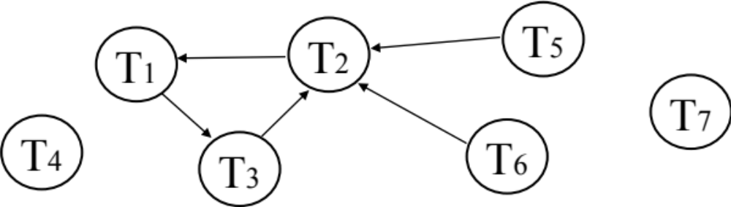
Deadlock Detection
Build Wait-For graph
  Ti → Tj: means Ti is waiting for Tj
Use lock table structures
Built incrementally by the scheduler
When cycle found, rollback victim
Select one among T1, T2, and T3 to kill (rollback)
➔ A good choice is “the most recent one”
Cycle (Deadlock)

Slide 18
Deadlock Prevention: Timeout
If transaction waits more than L sec., roll it back!
Pros: Simple scheme
Cons: Hard to select L
Check the other techniques in Textbook for your knowledge

Slide 19
Summary of Concurrency Control
How to manage multiple transactions at the same time
➔ and still ensure consistency
Schedules (order of actions)
  Serial, Conflict Serializable, Legal
Precedence Graphs for Conflict Serializable
Locking Protocol
  2PL, Handling of deadlocks

Slide 20


Transactions Under Failure
If we can guarantee
Case 1: Everything of transaction T is in memory
  Then it’s as if T never happened
Case 2: Everything of transaction T is on disk
  Then T is completed before the failure
Case 3: Part of of transaction T’s data is on disk
  Then we must recover from this inconsistent state

Slide 21
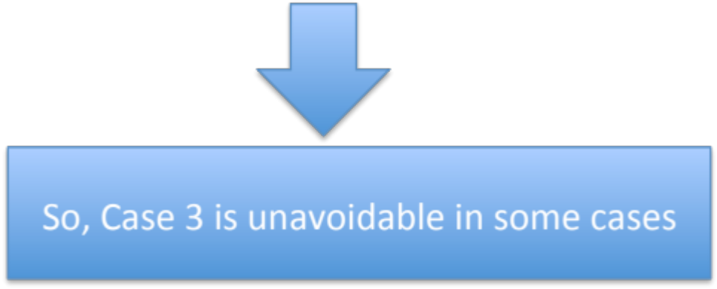
Why Case 3 is Possible
In many cases DBMS is forced to write some data to disk
  Reason 1: Memory is full
  Reason 2: Another transaction X needs to write its block B
    B happens to contain some data from transaction T

Slide 22


Logging Mechanism
Log the important actions of the transaction
Use the log for recovery when failure occurs
How to recover ?
  Undo incomplete transactions: Delete their effect
  Redo incomplete transactions: Do them again

Slide 23
Recovery Control
Undo Logging

Slide 24

Undo logging: Basic Idea
T1: Read (A,t); t ← t×2 A=B
Write (A,t);
Read (B,t); t ← t×2
Write (B,t);
Output-to-disk (A);
Output-to-disk (B);
Transaction T1 has modified A, and the old value is 8
<T1, start>
A:8
B:8
A:8
B:8
<T1, A, 8>
16
16
<T1, B, 8>
16
16
<T1, commit>
memory
disk
log

Slide 25
Undo Logging Rules
For every write action generate undo log record (containing old value)
(2) Before x is modified on disk (Output(x)),
➔ Log records pertaining to x must be on disk first (write ahead logging)
(3) Before <commit T> is written to log on disk, all writes of transaction must be written on disk

Slide 26
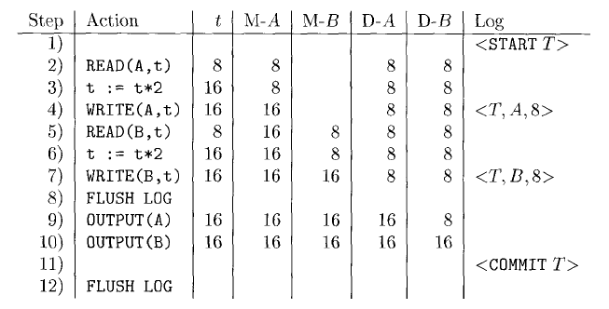
Example
Memory copy of A
Memory copy of B
Disk copy of A
Variable t
Disk copy of B
Log in memory
Before writing to disk, the corresponding log records must be on disk
Now T is considered Committed
T must end with either
<Commit T> or <Abort T>
(Still in memory)

Slide 27
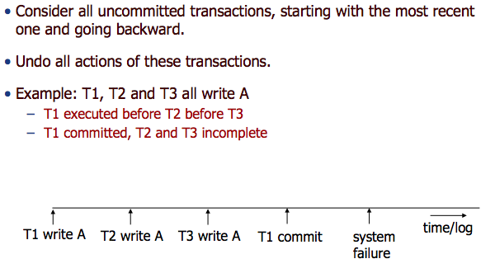
Recovery with Undo Logging

Slide 28
Undo Logging: Recovery Rules
For committed transactions (<Commit T> is written on disk)
➔ Do nothing
(2) Let S = set of transactions with <Ti, start> in log, but no
<Ti, commit> (or <Ti, abort>) record in log
(3) For each <Ti, X, v> in log,
// in reverse order (latest → earliest) do:
// write old value from log back to disk (only for S transactions):
- if Ti ∈ S then - write (X, v)
- output (X)
(4) For each Ti ∈ S do
- write <Ti, abort> to log

Slide 29

Example
➔Do Nothing

Slide 30
Example
➔<Commit T> is not written on disk yet
Need to undo T
  Change B → 8
  Change A → 8
Write in the log <Abort T>

Slide 31
Example
➔<Commit T> is not written on disk yet
Need to undo T
  Change B → 8 (Notice that B is in fact = 8 on disk….But no problem)
  Change A → 8
Write in the log <Abort T>

Slide 32
Recovery Control
Redo Logging

Slide 33

Disadvantage of Undo Logging
This forces the DBMS to make many I/Os
  Especially for small transactions

Slide 34
Rules for Redo Logging
For every write action, generate redo log record.
  <T, X, v>: Transaction T has modified X and new value is v
Flush log at commit.
Before modifying any value X on disk (Output(X))
  All log records of T (including commit) must be on disk before X is modified on disk
Write <END T> log record after DB modifications have been written to disk.

Slide 35
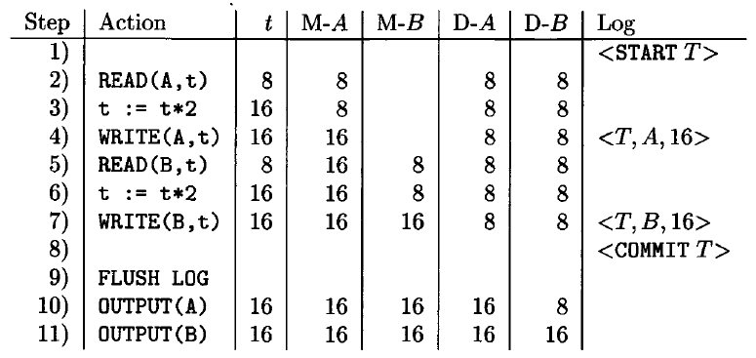
Example
That is the new value
No Output can be done until the Log is flushed to disk containing all T’s records and its <Commit T>

Slide 36
Redo Logging: Recovery Rules
Check the log
T with no <Commit T>
  Can be ignored (do nothing)
  Because T did not write anything to disk
T with <End T>
  Can be ignored (do nothing)
  Because T wrote all its data to disk
T with <Commit T> but no <End T>
  Redo its actions (Start from <Start T> and move forward)

Slide 37
Example
➔<Commit T> is not written on disk yet
Do Nothing

Slide 38
Example
➔<Commit T> is on disk, No <End T>
Redo T
  Copy 16 to A
  Copy 16 to B
Add <End T> to log and write to disk

Slide 39

Disadvantage of Redo Logging
Delayed I/Os
  Needs to keep all modified blocks in memory until T commits
Bad especially for large transactions

Slide 40
Disadvantage of Undo Logging
Cannot consider T committed and write this log rec until all T’s updates are written to disk
This forces the DBMS to make many I/Os
  Especially for small transactions

Slide 41
Disadvantage of Redo Logging
Cannot write anything of T’s updates to disk until it commits.
Delayed I/Os
  Needs to keep all modified blocks in memory until T commits
Bad especially for large transactions

Slide 42
Next: Undo/Redo Logging

Slide 43
Undo/Redo Logging
Stores more data in its log to offer more flexibility
  Log record: <Ti, X, oldVal, newVal>
Transation Ti has updated X, the old value is oldVal and the new value is newVal
In Recovery
  Some transactions will be undone (incomplete ones)
  Some transactions will be redone (complete ones)

Slide 44


Undo/Redo Logging
For every write action, generate log record.
  <T, X, old, new>: Transaction T has modified X from old to new
Before writing any object X to disk (Output(x)), its log record must be on disk
Yes
A block containing X can now move to disk either before or after the commit
Yes

Slide 45
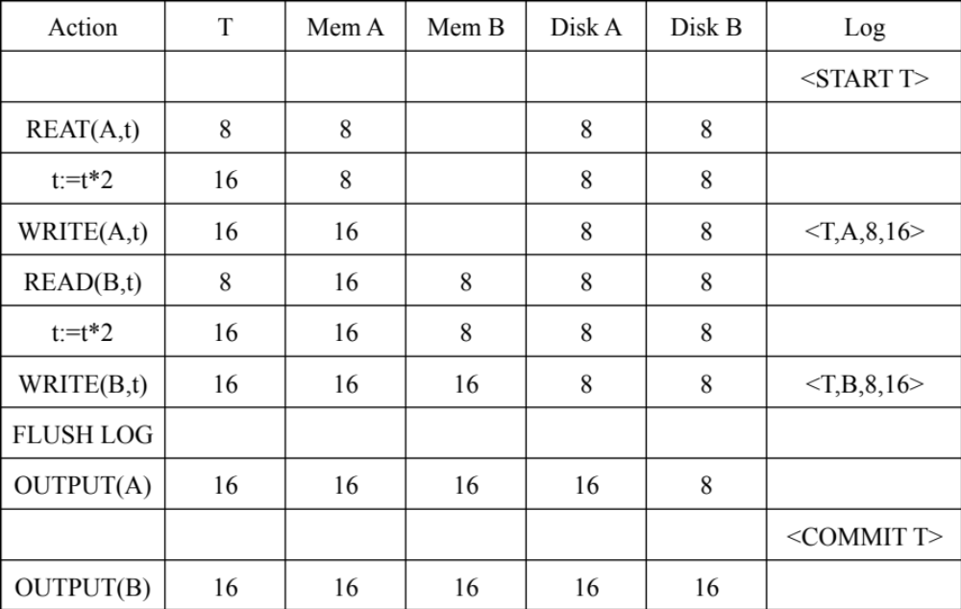
Example
At this point it is allowed to write either A or B to disk
At this point T is considered completed although some of its data is not written yet to disk

Slide 46

Undo/Redo Logging: Recovery Rules
If <Commit T> is in the log (on disk)
  It means T is completed
  Some data may be written to disk, other data may not
If <Commit T> is not in the log (not on disk)
  Still some data may be written to disk
Redo T (top-down)
Undo T (bottom-up)

Slide 47

Undo/Redo Logging: Recovery Rules
Redo Phase
Decide on which transactions to redo (can be many)
Take one forward pass (top-down) and redo them
Undo Phase
Decide on which transactions to undo (can be many)
Take one backward pass (bottom-up) to undo them

Slide 48
Example
Log on disk
<START T1>
<T1,X1,u1,v1>
<START T2>
<T2, X2,u2,v2>
<START T3>
<T1,X3,u3,v3>
<COMMIT T2>
<T3,X4,u4,v4>
<T1,X5,u5,v5>
Redo T2
Undo T1, T3
crash

Slide 49
Example
The <Commit T> record is not written yet to disk
T is considered incomplete and will be undone
- Return B to 8
- Return A to 8

Slide 50
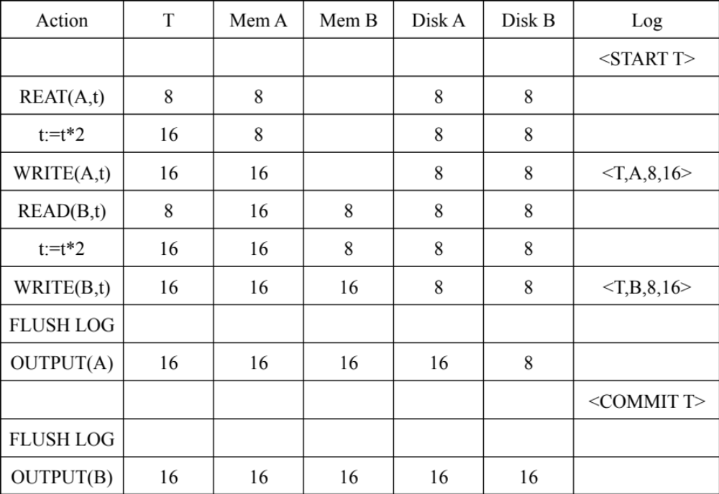
Example
The <Commit T> record is on disk
T is considered complete and will be redone
- Copy 16 to A
- Copy 16 to B

Slide 51
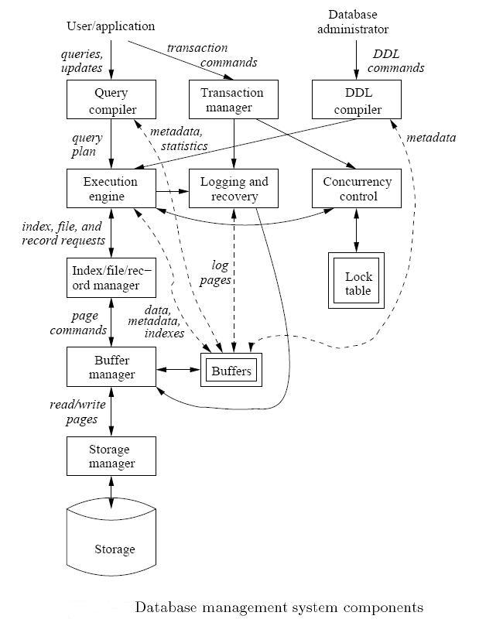
We Are Done…

